Slide 1

FINANCIAL SENTIMENT ANALYSIS
GROUP 3
Mentor: Karthik musukula
Submentor:K.S.siri

Slide 2
Members
Vyshnavi Kolla
Vivek Kumar Singh
Shilpi Rani
L. Abhishek
Avinash
Chaitrali Sorte
Rakesh

Slide 3
Contents
Business Objective
About Dataset
Libraries Used
Data Cleaning
Text Processing
Explaratory Data Analysis
Feature Engineering
Feature Extraction
Model Building
Deployment
Conclusion

Slide 4
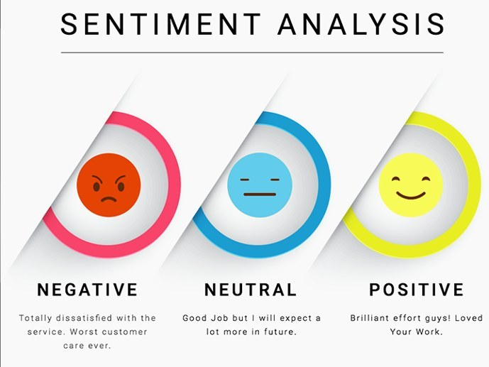
BUSINESS OBJECTIVE
The primary objective of consolidating the FiQA and Financial PhraseBank datasets into a unified CSV file is to advance financial sentiment analysis research. By combining these datasets, we aim to provide a comprehensive and accessible resource for researchers and practitioners in the financial domain.
The business goal is to facilitate the development and improvement of sentiment analysis models specifically tailored to financial language, enabling more accurate and nuanced predictions of sentiment within the context of financial sentences.

Slide 5
ABOUT DATASET
Dataset Information
Number of Entries: 5842
Columns:
Sentence: Textual data containing financial news or statements.
Sentiment: Categorical label indicating sentiment (positive, negative, or neutral).
Data Types
Both columns are of type 'object'.
No missing values in either column.

Slide 6
Libraries used
Pandas (pd):
Efficient data manipulation and analysis.
DataFrames simplify working with structured data.
NumPy (np):
Performs diverse mathematical operations on arrays.
Supports large, multi-dimensional arrays and matrices.
Seaborn (sns):
Statistical data visualization library.
Based on Matplotlib, provides a high-level interface.
Matplotlib.pyplot (plt):
Versatile plotting library for static, animated, and interactive visualizations.
Pyplot module offers a convenient plot creation interface.

Slide 7
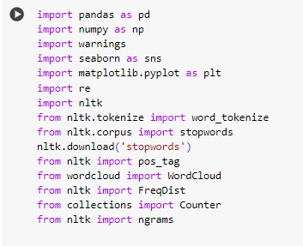
NLTK:
Natural Language Toolkit for human language data.
Tools for tokenization, stemming, tagging, parsing, etc.
TextBlob:
Simple NLP library with a consistent API.
Tasks include part-of-speech tagging and sentiment analysis
Re:
Supports regular expressions in Python.
Powerful tools for pattern matching and string manipulation
XGBoost Classifier :
The XGBoost Classifier is an implementation of the XGBoost (Extreme Gradient Boosting) algorithm for classification tasks within the scikit-learn library in Python.

Slide 8
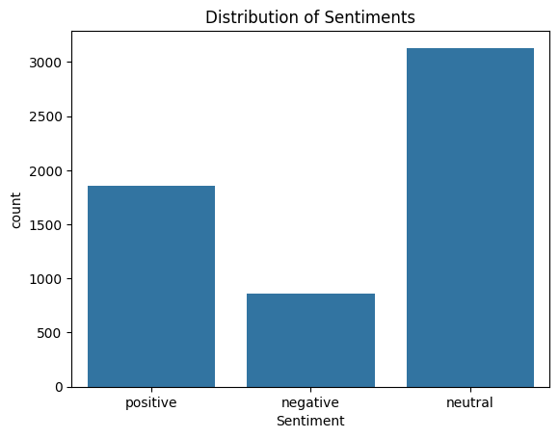
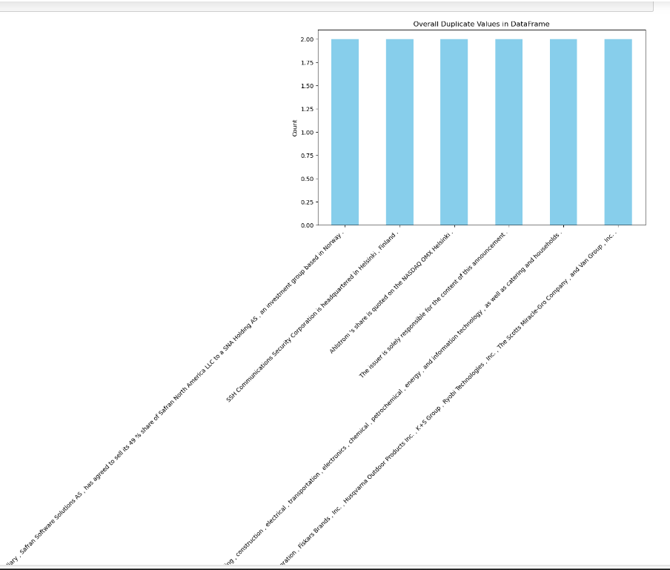
DATA CLEANING
Missing Values
Checked for missing values: None found.
Sentiment Analysis
Discovered three unique sentiments in the dataset.
Sentence Analysis
Identified a total of 5322 unique sentences.
Found 12 duplicate sentences in the dataset.
Overall, there were 6 unique sentences duplicated.
Handling Duplicates
Removed the overall duplicates in the entire DataFrame.

Slide 9
Text Processing
Data Cleaning in Sentence Column
Replaced hyphens with spaces in the 'Sentence' column.
Cleaning Special Characters and Numbers
Created a function to remove URLs, special characters, and numbers.
Applied the cleaning function and stored the results in a new column 'Clean_Sentence’.
Case Changing
Converted the 'Clean_Sentence' column to lowercase.
Tokenization and Lemmatization
Tokenized the 'Clean_Sentence' column using NLTK's word_tokenize.
Lemmatized the tokenized sentences using WordNetLemmatizer.

Slide 10
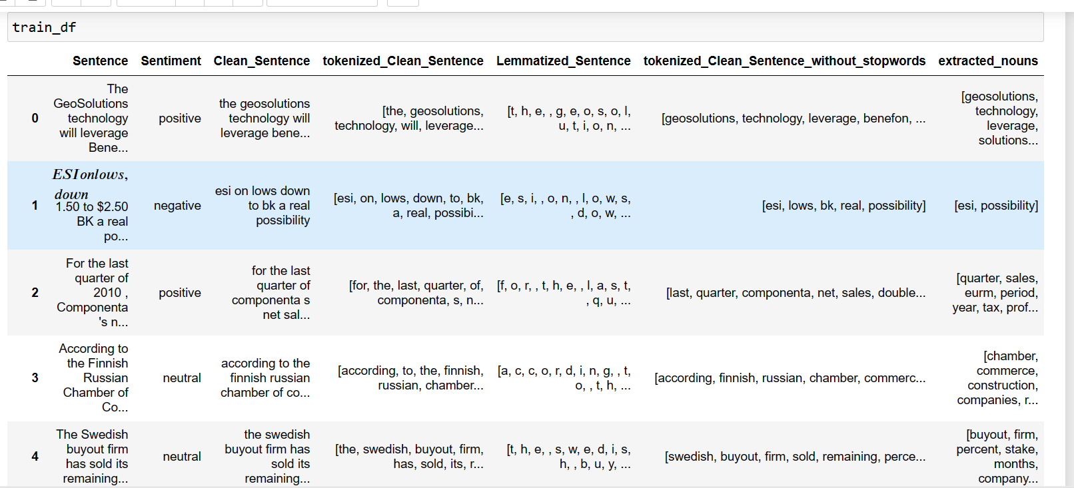
Removing Stop Words
Removed stop words from the tokenized sentences.
Extracting Nouns
Extracted nouns from tokenized sentences using Part-of-Speech tagging.
Sentiment-Specific Analysis
Extracted rows for neutral, positive, and negative sentiments for further analysis.
Final DataFrame
Displayed the final DataFrame with additional columns.

Slide 11
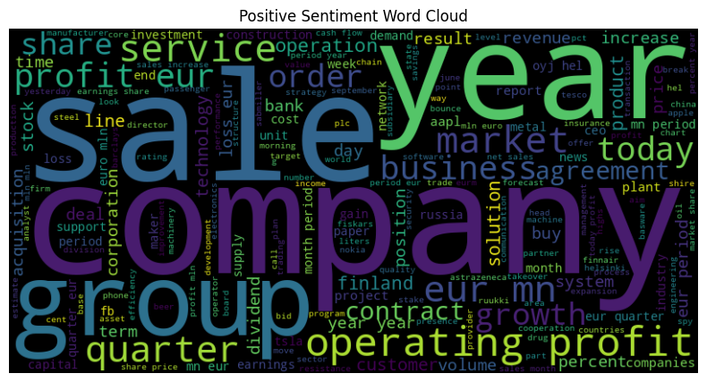
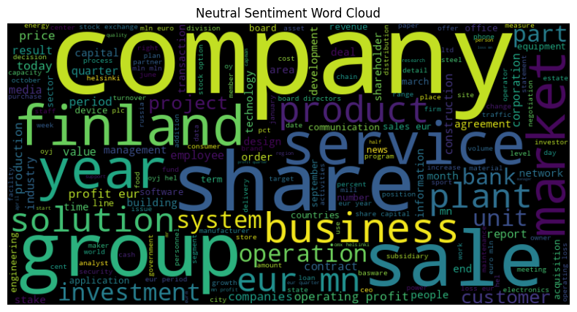
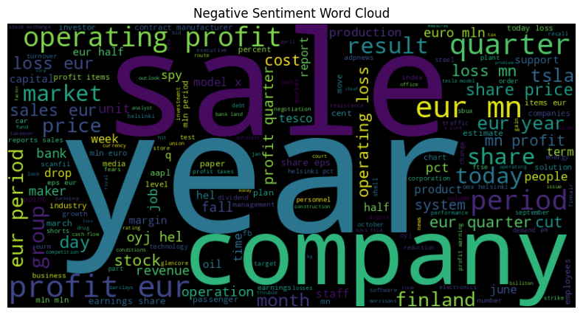
EXPLORATORY DATA ANALYSIS (EDA)
Word Clouds for Sentiments
Generated word clouds for each sentiment category.
Positive Sentiment
Neutral Sentiment
Negative Sentiment

Slide 12
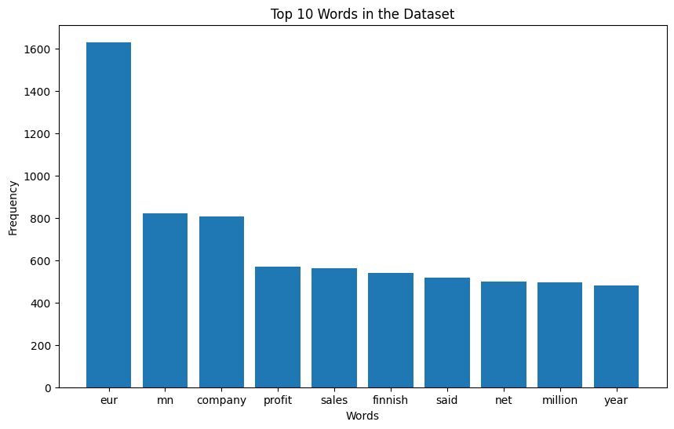
Top Words in the Dataset
Analyzed word frequency in the cleaned dataset.
Plotted a bar chart showcasing the top 10 words.

Slide 13
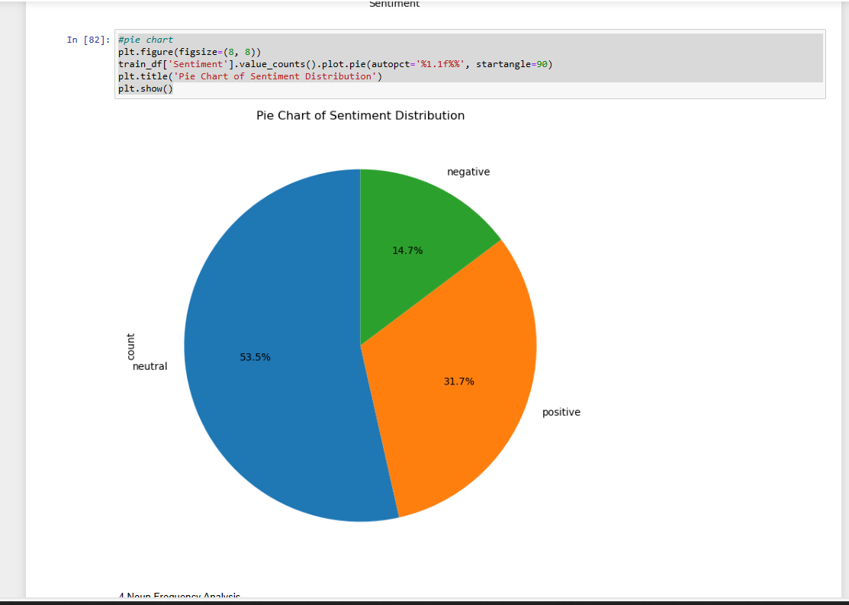
Sentiment Distribution
Visualized the distribution of sentiments in the dataset.
Utilized bar plots and a pie chart to represent sentiment proportions.

Slide 14
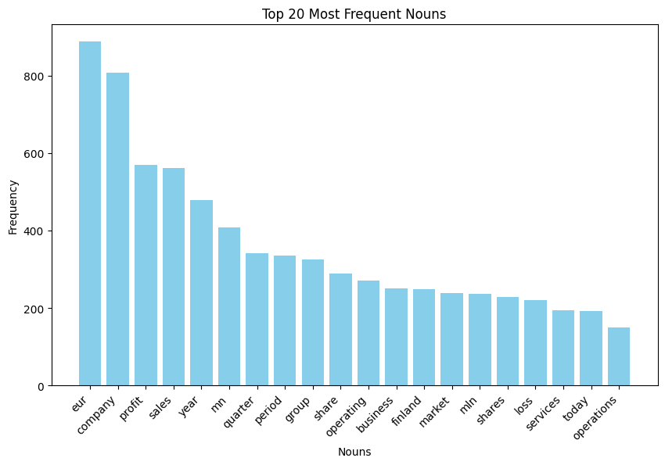
Noun Frequency Analysis
Explored the frequency of extracted nouns.
Created a bar plot displaying the top 20 most frequent nouns.

Slide 15
Feature engineering
We created a new column 'cleaned_Sentence' by joining the tokenized and cleaned words from the 'tokenized_Clean_Sentence_without_stopwords' column.
Label Encoding:
We used “Label Encoder” from scikit-learn to encode the “sentiment” column into numeric values,and stored it in the “Encoded_Sentiment” column.
Sentiment Analysis with TextBlob:
We applied TextBlob to calculate sentiment polarity for the cleaned sentences, stored in the 'Sentiment_Polarity_Cleaned' column.
Created a new column 'Sentiment_Label_Cleaned' based on the sentiment polarity, categorizing them as 'positive,' 'neutral,' or 'negative.
Created a new column ‘Sentiment_label_encoded’ based on the ‘Sentiment_label_Cleaned’ categorizing them as 2,1,0.

Slide 16
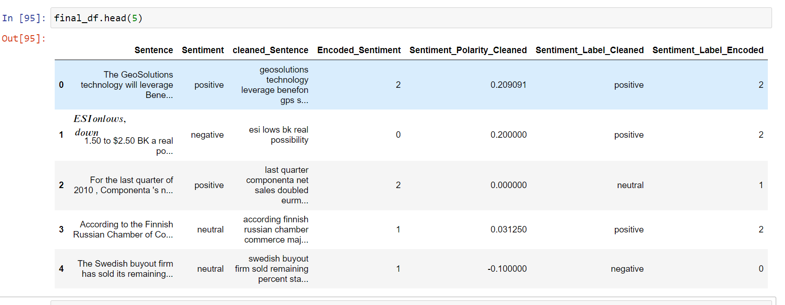

Slide 17
FEATURE EXTRACTION
N-gram Analysis Overview
Introduced the concept of N-grams and their significance in understanding language patterns.
Unigram Analysis
Present the top 10 most common unigrams in the dataset.
Discuss the frequency of each unigram and its relevance.
Utilize a bar chart for a visual representation of the findings

Slide 18
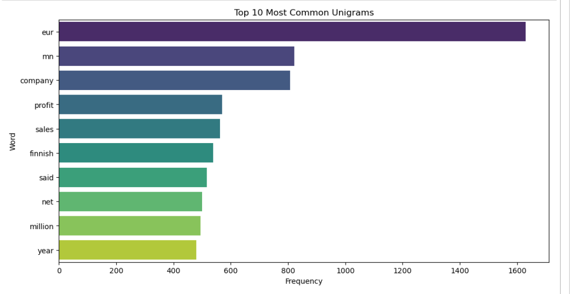

Slide 19
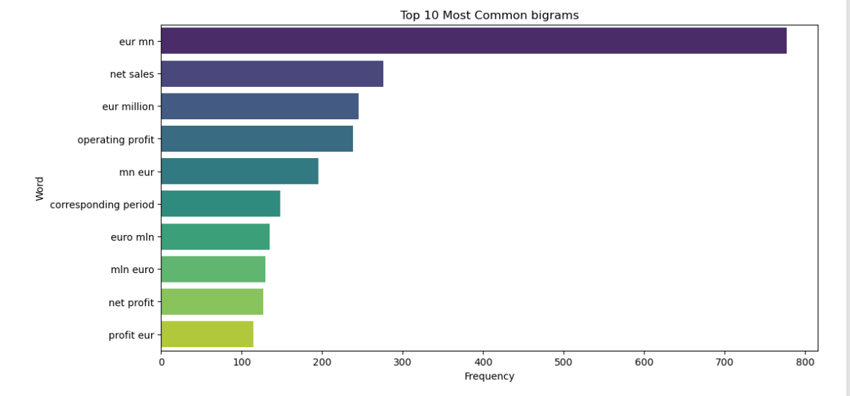
Bigram Analysis
Explore the top 10 most common bigrams in the dataset.
Explain the importance of analyzing pairs of words for deeper insights.
Visualize the results with a bar chart for better understanding.

Slide 20
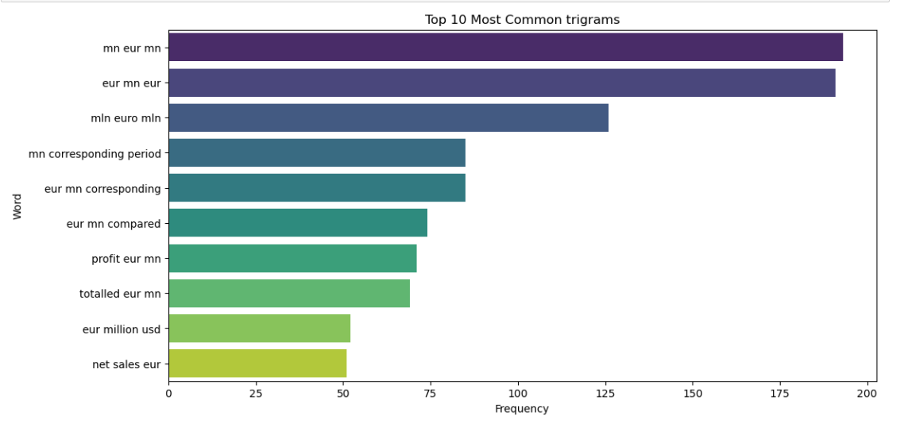
Trigram Analysis
Uncover the top 10 most common trigrams in the dataset.
Discuss the significance of trigrams in capturing more complex language patterns.
Utilize a bar chart to visually represent the frequency of trigrams.

Slide 21
MODEL BUILDING
Algorithm: Xgboost classifier combined with TF-IDF Vectorizer
Target Variable:Sentiment_Label_Encoded
The model underwent training and evaluation using a train-test split on the dataset.
We utilized a TF-IDF vectorizer combined with the XGBoost classifier through a pipeline in building the model.
We calculated training and test accuracy and overall accuracy.Results showed 94% accuracy on the training set , 90% accuracy on the test set and over all accuracy is 90%.

Slide 22
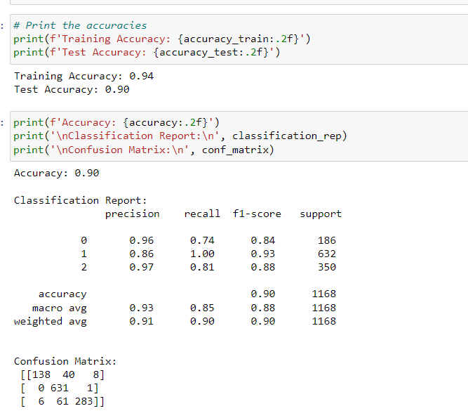
The model's performance was comprehensively analyzed using a classification report. This report provided valuable insights into precision, recall, and F1-score for each sentiment class.

Slide 23
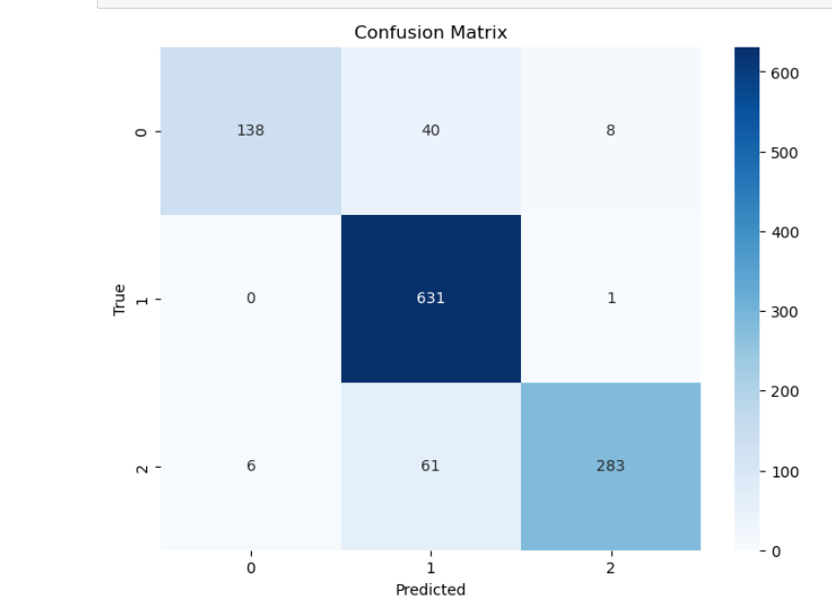
Collectively, these metrics underscore the effectiveness of the TF-IDF vectorization and XGBoost model in accurately predicting sentiment labels within our dataset.

Slide 24
Deployment Essentials:
Generated Files:
model.sav: Contains the trained model.
Requirements.txt: contains the packages which we need to install for deployment
app.py: contains the interface for the web application
This structure allows for efficient utilization and deployment across applications.

Slide 25
DEPLOYMENT
Need of Deployment :
Deploying a model at the end of a project is a crucial step that involves making the model available for use in real-world applications.
Deploying a model using an application(app) provides us several advantages such as making it accessible to a broader audience, Enhanced user experience, Real Time Interaction and Customization.
Libraries Used :
Pandas : Pandas is a popular open-source Python library used for data manipulation and analysis.
Streamlit : Streamlit is a Python library that simplifies the process of creating interactive web applications for data science and machine learning projects.

Slide 26
XGBoost Classifier :The XGBoost Classifier is an implementation of the XGBoost (Extreme Gradient Boosting) algorithm for classification tasks within the scikit-learn library in Python.
Scikit-learn : Scikit-learn is a comprehensive and widely-used machine learning library in Python that provides a unified toolkit for various machine learning tasks.
Joblib : A Python library that provides tools for efficient parallel computing and data serialization.
Streamlit.io :Streamlit is a free and open-source framework to rapidly build and share beautiful machine learning and data science web apps.

Slide 27
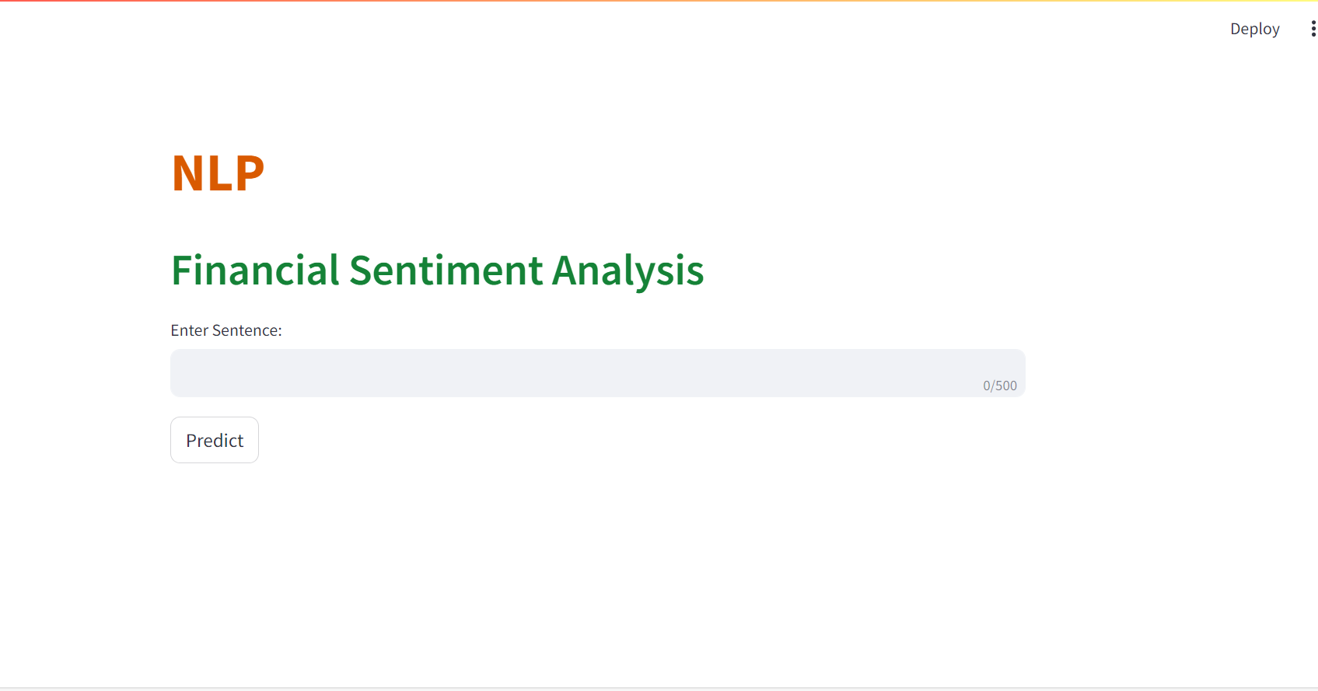
Global Deployment :
Link:https://nlpproject-nbuxhkq4z5tcjd5xchptiw.streamlit.app

Slide 28
Challenges faced in financial sentiment analysis
Inconsistent Sentiment in Duplicate Sentences
Challenge: Inconsistent Sentiments in Duplicate Sentences.
Impact: Potential Bias and Reduced Model Reliability
Solution: Implemented Consistency Checks and Quality Assurance
Details: Manually Reviewed and Corrected Sentiments with duplicate sentences
Outcome: Enhanced Data Quality and Consistency
Justification: Achieved Noise-Free Dataset, Improving Model Reliability

Slide 29
Complexity of Financial Language and Need for Interpretability
Challenge: The intricate nature of financial language poses a challenge in choosing a model that not only captures nuanced sentiment patterns but is also interpretable for effective decision-making.
Impacts: Biased Decisions,Reduced Trust,Missed opportunities,regulatory compliance risks
Solution: Thorough Evaluation of Models
Details: Checked accuracy, recall, precision, and F1 score for each model.
Outcome: Optimal Model Identified
Justification: Chose the model that excelled across all key metrics.

Slide 30
Local and Global Deployment Challenge
Challenge: Deployment Issues: Local and Global
Impact:
Operational Disruption: Attribute Error Hindered Sentiment Prediction.
User Experience Impact: Deployed System Fails to Providing Predictions.
Solution: Streamlining Local and Global Deployment
Details:
Conducted Comprehensive Testing Locally.
Implemented Robust Error Handling Mechanisms.
Ensured Compatibility with Global Infrastructure.

Slide 31
Outcome: Error-Free Deployment Achieved
Justification: Implemented Measures Resulted in a Seamless Deployment Experience, Eliminating Operational Disruptions and Enhancing User Satisfaction.

Slide 32
CONCLUSION
The development of a user-friendly deployment, incorporating consolidated FiQA and Financial PhraseBank datasets, signifies a significant stride in financial sentiment analysis research.
This tool facilitates seamless exploration and analysis of financial sentences, providing a valuable resource for researchers, analysts, and practitioners in the financial domain.
The user-friendly interface ensures accessibility, enabling efficient extraction of insights into sentiments associated with financial data.
The integration of sophisticated sentiment analysis models, tailored to financial language nuances, enhances the accuracy and granularity of sentiment predictions.
This deployment streamlines the sentiment analysis process, contributing to the democratization of financial insights.

Slide 33
It empowers users to make more informed decisions by leveraging advanced natural language processing techniques on a comprehensive dataset.
In conclusion, the user-friendly deployment represents a pivotal step toward advancing financial sentiment analysis, fostering greater understanding, and enabling strategic decision-making in the financial sector.

Slide 34

Thank
YOU

